Slide 1
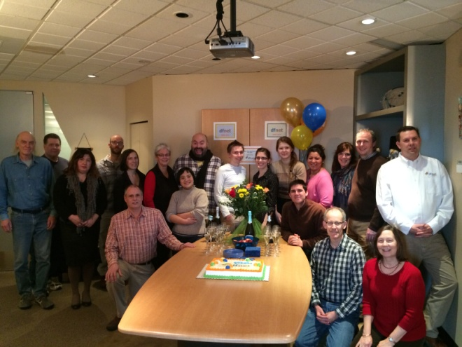


MTN-028 Frontier Science & Technology Research Foundation (FSTRF)
Web Randomization System
Bambi Arnold-Bush
SCHARP MTN-028 Project Manager
Notes:
Randomization System with Frontier Science & Technology Research Foundation, Inc. (FSTRF)

Slide 2
Account registration with FSTRF
CRS staff must have a MTN-028 FSTRF user account in order to access the system and randomize participants.
CRS needs to identify the clinic coordinators, the pharmacist and back-up pharmacist who will receive the randomization notices.
To register with FSTRF, go to the FSTRF Portal: https://www.fstrf.org/apps/cfmx/apps/common/Portal/index.cfm

Slide 3
Account registration with FSTRF
If you already have a FSTRF account with another network, you must still register for an MTN account via the FSTRF Portal. Use the same e-mail and password to request the MTN account.
Once you open an account for the MTN you will be able to register for all future MTN protocols.
You will receive a notification via e-mail when your MTN account is setup.

Slide 4
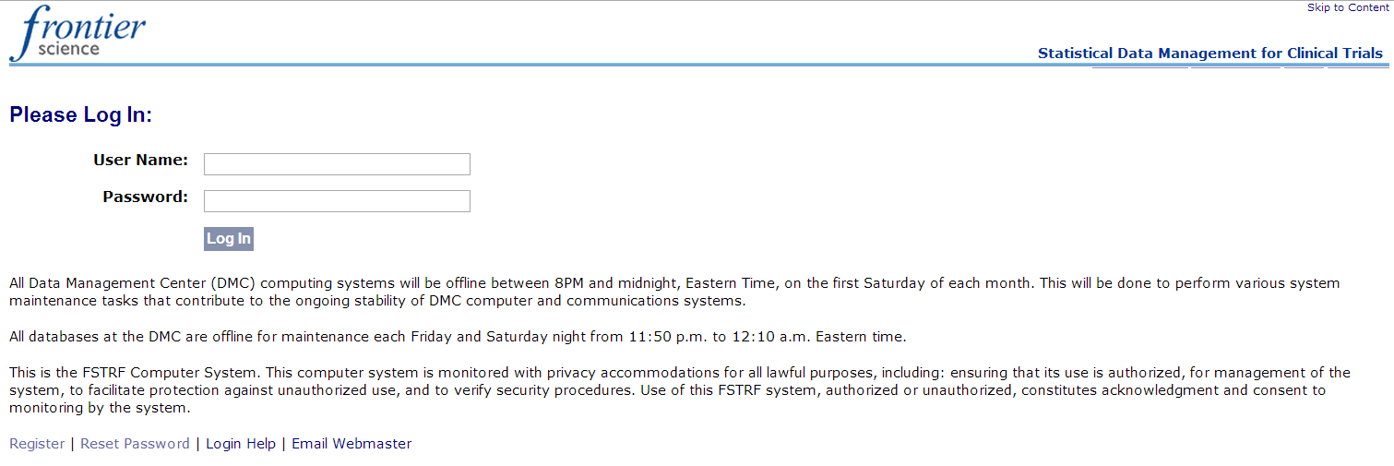
Account registration with FSTRF

Slide 5
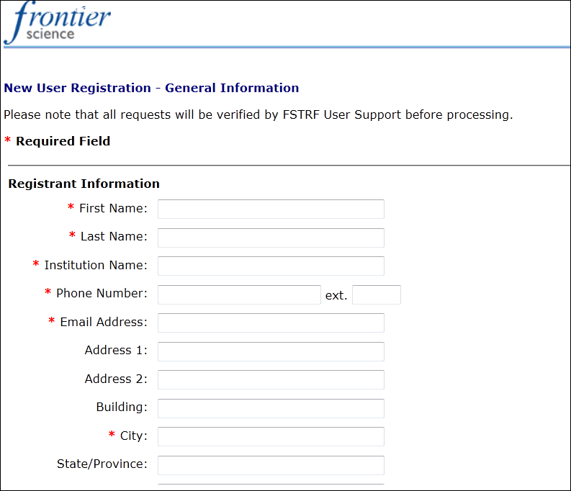
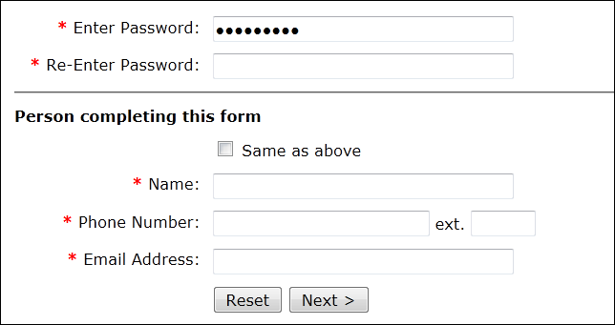
Account registration with FSTRF
1. Complete registration information
2. Enter password
3. If you registered yourself, check the box for “same as above”.
4. If you are requesting an account for another staff, enter your own information under “Person completing this form”.
5. Proceed with instructions
Notes:
The password that you enter will be the password that you will use to access the system moving forward once an account has been created. Please ensure that your password is saved in a secure location for future use.

Slide 6
When to randomize?
At the Enrollment Visit (2.0), once participant all eligibility criteria are (or have been) confirmed by investigator or designee
Randomization is the process whereby a participant is assigned to a study treatment arm
Randomization = Enrollment!

Slide 7
How to randomize participants
1. Log onto: www.fstrf.org/Portal
Notes:
Log onto the FSTRF system and log in using your FSTRF Randomization System username and password.

Slide 8
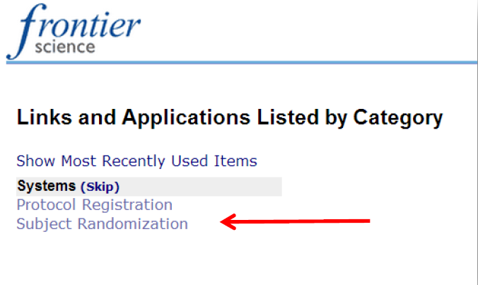
How to randomize participants
2. Click on “Subject Randomization” on welcome page

Slide 9
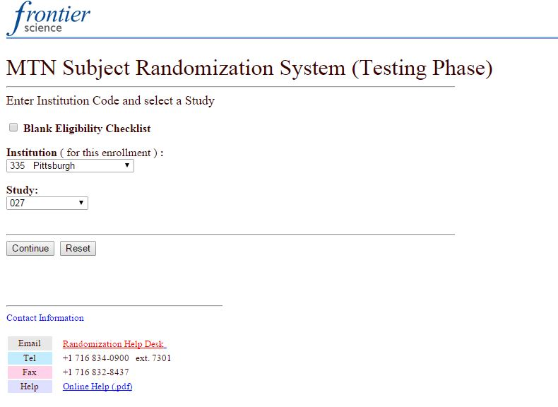
How to randomize participants
3. Select your institution and study on the Randomization Screen
Notes:
From the randomization screen, use the drop down menus provided to select your institution and study, then click “Continue”. You can disregard the check box for “Blank eligibility checklist” as this does not apply to MTN-028.

Slide 10
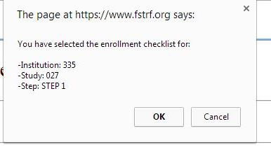
How to randomize participants
4. Confirm study and site details
Notes:
A pop up box will confirm your site DataFax number and protocol number. Click Ok.

Slide 11
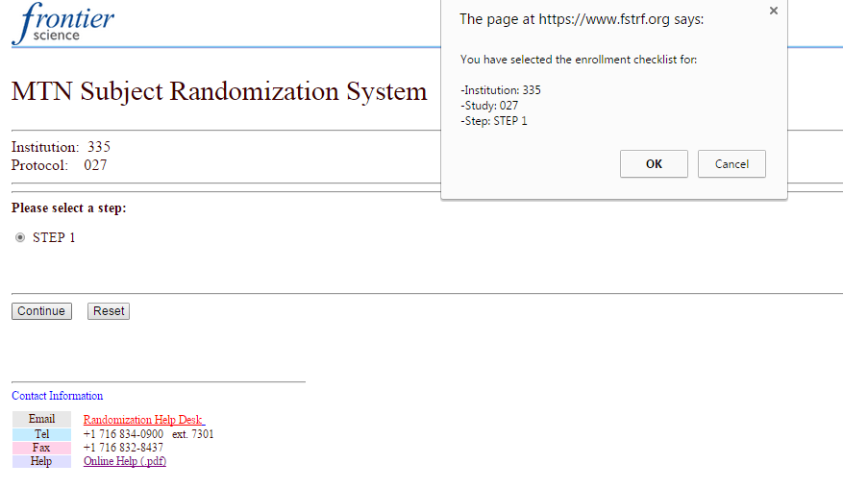
How to randomize participants
5. Click “Continue” on next pre-filled page
Notes:
The next page is pre-filled with your site ‘institution’ and protocol numbers. Click “Continue”. A second pop-up box will appear confirming the randomization details once again. Click “Ok”.
The parenthetical testing phase phrase is visible in the screen shot as the live MTN-028 randomization system has not yet been activated. When you actually go into the system to randomize participants, this will no longer appear.

Slide 12
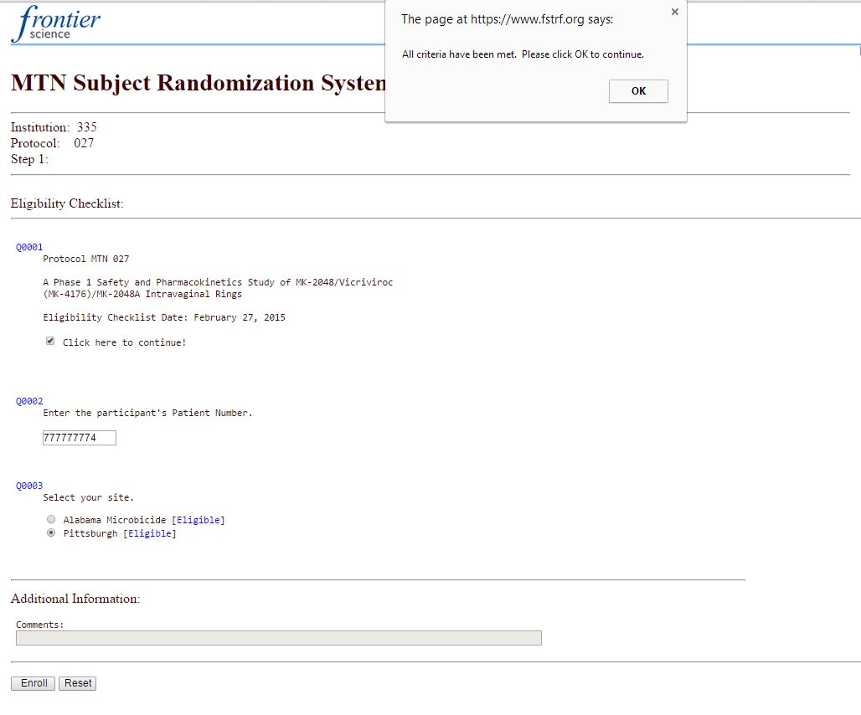
How to randomize participants
6. On the next page, select the box “Click here to Continue!”, enter the PTID without dashes, and hit enter.
Click “OK’ when the confirmation box pops-up after hitting enter.
Notes:
On the next screen, select the box for “Click here to continue!” Enter the participant’s Participant ID Number (e.g. PTID), without dashes, in the space provided and hit the “Enter” key on your keyboard. You must enter a valid PTID to proceed. Your site will already be pre-selected. Click “OK” in the confirmation pop-up box.

Slide 13
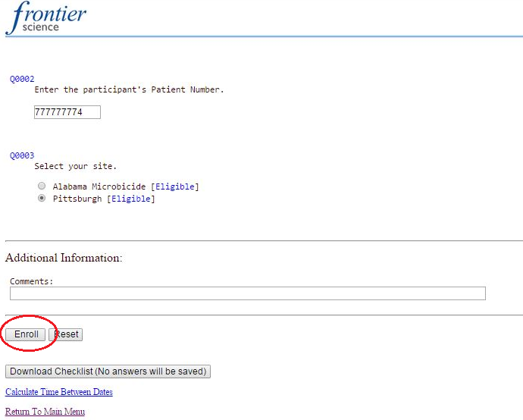
How to randomize participants
7. Click “Enroll” at the bottom of the page

Slide 14
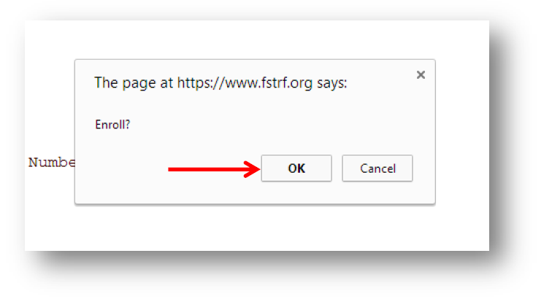
How to randomize participants
7. Click “Ok” in the pop-up box to confirm Enrollment

Slide 15
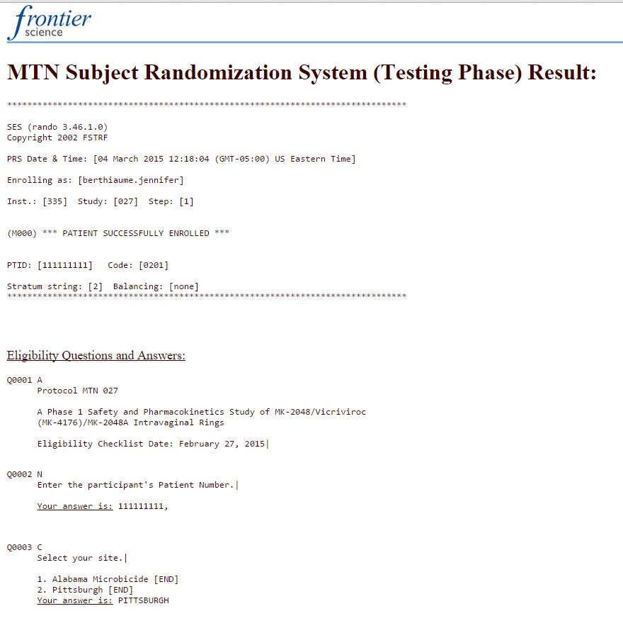
Randomization Confirmation notices
Notes:
When a participant has been successfully randomized, you will see this message in your web browser to confirm that the participant has been randomized.
This notice include date of randomization, CRS clinic staff member name, DataFax site number (Inst.), study number, PTID, site location, and the randomization number (Code).

Slide 16
Randomization Confirmation notices
Notice includes:
Date of randomization
CRS Clinic staff member name
DataFax site number (Inst.)
Study Number
PTID
Site Location
Randomization number (Code)
The notice will also be emailed to the CRS Clinic Coordinator, CRS Pharmacist alias
Notes:
A notification of randomization will also be sent via e-mail to CRS Clinic Coordinator and CRS Pharmacist and back-up Pharmacists, and other designees as assigned by the clinic coordinator/site IoR

Slide 17
Randomization Confirmation notices
Once randomization notice is received, CRS staff must:
Write the randomization number (code) on the MTN-028 Prescription before sending to the site Pharmacy. This code will also be transcribed onto the Enrollment CRF
Print 2 copies:
  1 for participant file
  1 to travel with prescription to pharmacy
Store notice in secure location
Refer to SSP Section 7 for additional guidance on study product dispensation considerations for clinic staff

Slide 18

Logging out
To log out of the FSTRF system, click on “skip to content” in the upper right corner of the screen to reveal a menu bar with a logout option.

Slide 19
Participant Replacement
Bambi Arnold-Bush
SCHARP MTN-028 Project Manager

Slide 20
Participant Replacement
Participants will be replaced if:
  The participant is terminated early for any reason (e.g. pregnancy, HIV status, clinician discretion, permanent product discontinuation, participant voluntary withdraw)
  The participant has had the ring out for more than 3 consecutive days, voluntarily or by site’s decision.
  The participant misses 3 (consecutive) visits

Slide 21
Participant Replacement
The purpose of replacing participants is to compensate for the potential data loss due to loss of follow-up and/or on temporary hold or permanent product discontinuation.
If a participant discontinues study participation or is placed on hold (and the ring has been out for longer than three days) and needs to be replaced contact the MTN-028 Management Team immediately (mtn028mgmt@mtnstopshiv.org).

Slide 22
Participant Replacement
If a participant discontinues study participation or is placed on hold (and the ring has been out for longer than three consecutive days) the participant needs to be replaced, and the following steps should be completed:
Inform the MTN-028 Management Team immediately (mtn028mgmt@mtnstopshiv.org)
Once the site receives confirmation from the SCHARP Project Manager that the participant does need to be replaced:
  contact FSTRF to let them know that there is a participant that needs to be replaced.
  The email to FSTRF should include the PTID for the participant that needs to be replaced.

Slide 23
Participant Replacement
After FSTRF notifies the site that the randomization system is ready to replace the participant:
  the next eligible participant will be enrolled as a replacement participant.
  The replacement participant will be assigned a new PTID and the site clinic staff will complete the steps for randomization using the FSTRF website.
  The replacement participant will be assigned to the same product as the participant being replaced via the FSTRF website.
The reason that the participant is being replaced should be documented on the Participant Replacement CRF.
The PTID for the participant being replaced should be documented on the replacement participant’s Enrollment CRF.
NOTE: FSTRF’s operating hours for assistance with randomization are 6AM – 5PM Eastern
Notes:
If it is determined that a participant must be replaced after 5PM Eastern (2PM Pacific) and another patient is already scheduled to be randomized that afternoon, that patient can be randomized. Site staff should still email FSTRF informing them that a participant needs to be replaced and the next day when FSTRF informs the site that the randomization system is ready to replace the participant, the next eligible patient randomized will be assigned the same product as the discontinued participant.

Slide 24
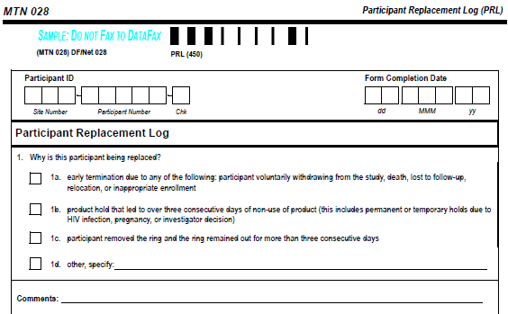
Participant Replacement Log

Slide 25
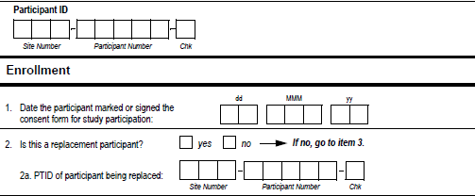
Participant Replacement
Enter the PTID of the participant being replaced on the Enrollment CRF

Slide 26
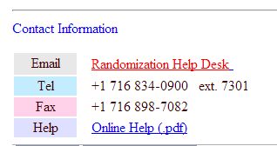
Resources and Help
MTN-028 SSP Section 6: Web Randomization
On FSTRF Webpage:
Once you are registered you will have access to the FSRTF users manual by clicking on the “Help” tab

Slide 27

Questions/Operational Issues?
Please contact MTN-028 Project Manager, Bambi Arnold-Bush: barnoldb@scharp.org and the Statistical Research Associate

